Slide 1
VISIT TO LABORATORIES
III B. Sc. ZOOLOGY (TAMIL MEDIUM)
24.01.2019

Slide 2
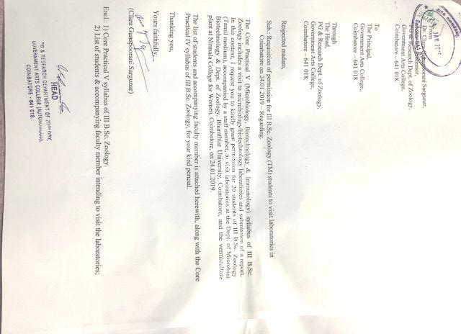
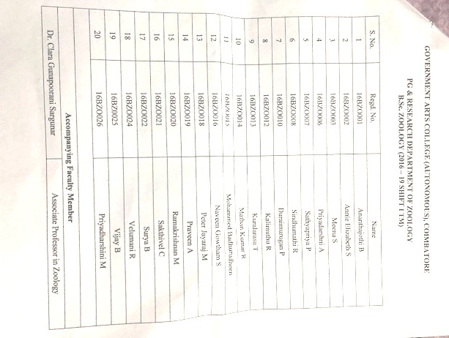

Slide 3
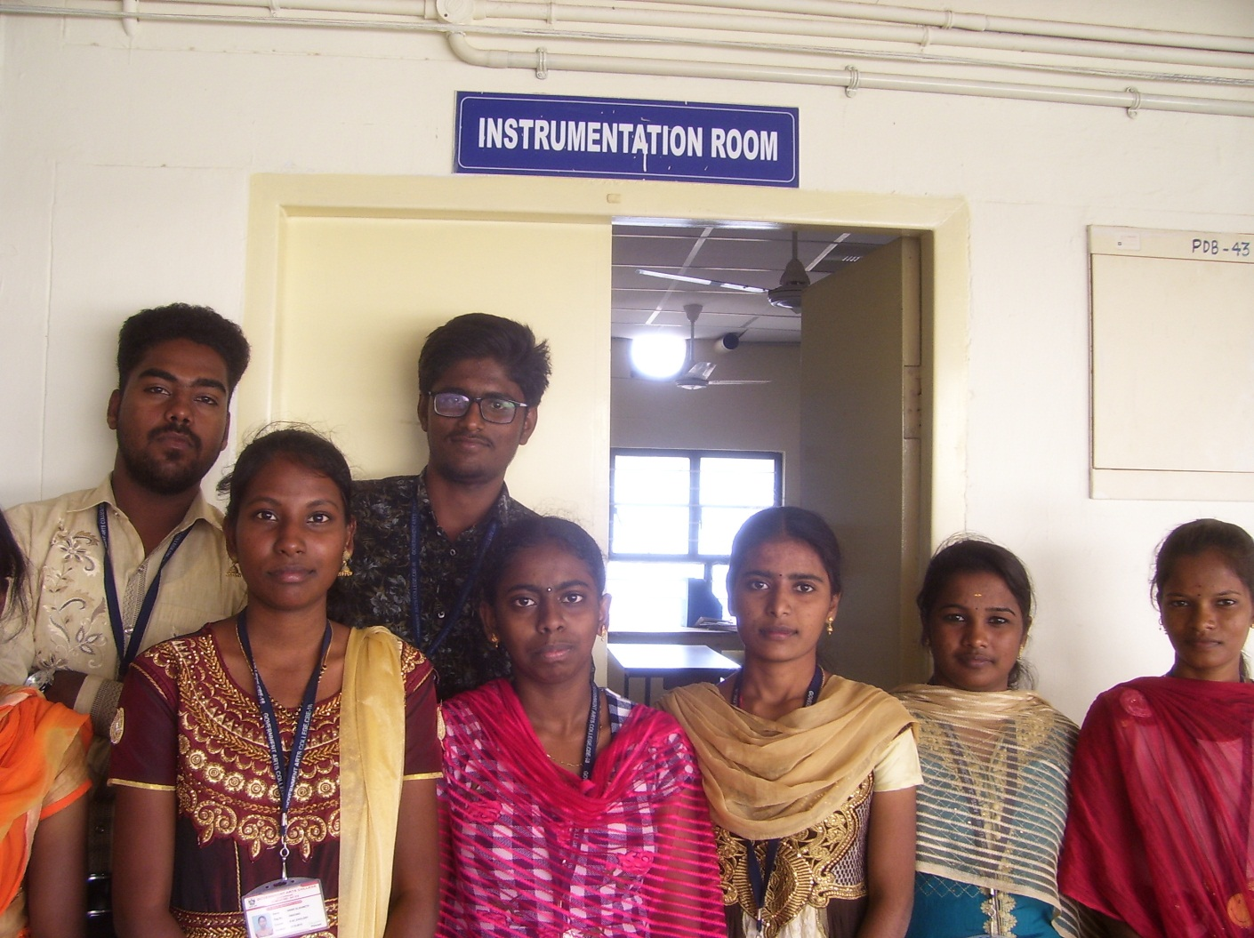
Dept. of Microbial Biotechnology, Bharathiar University, Coimbatore
Instrumentation Room

Slide 4
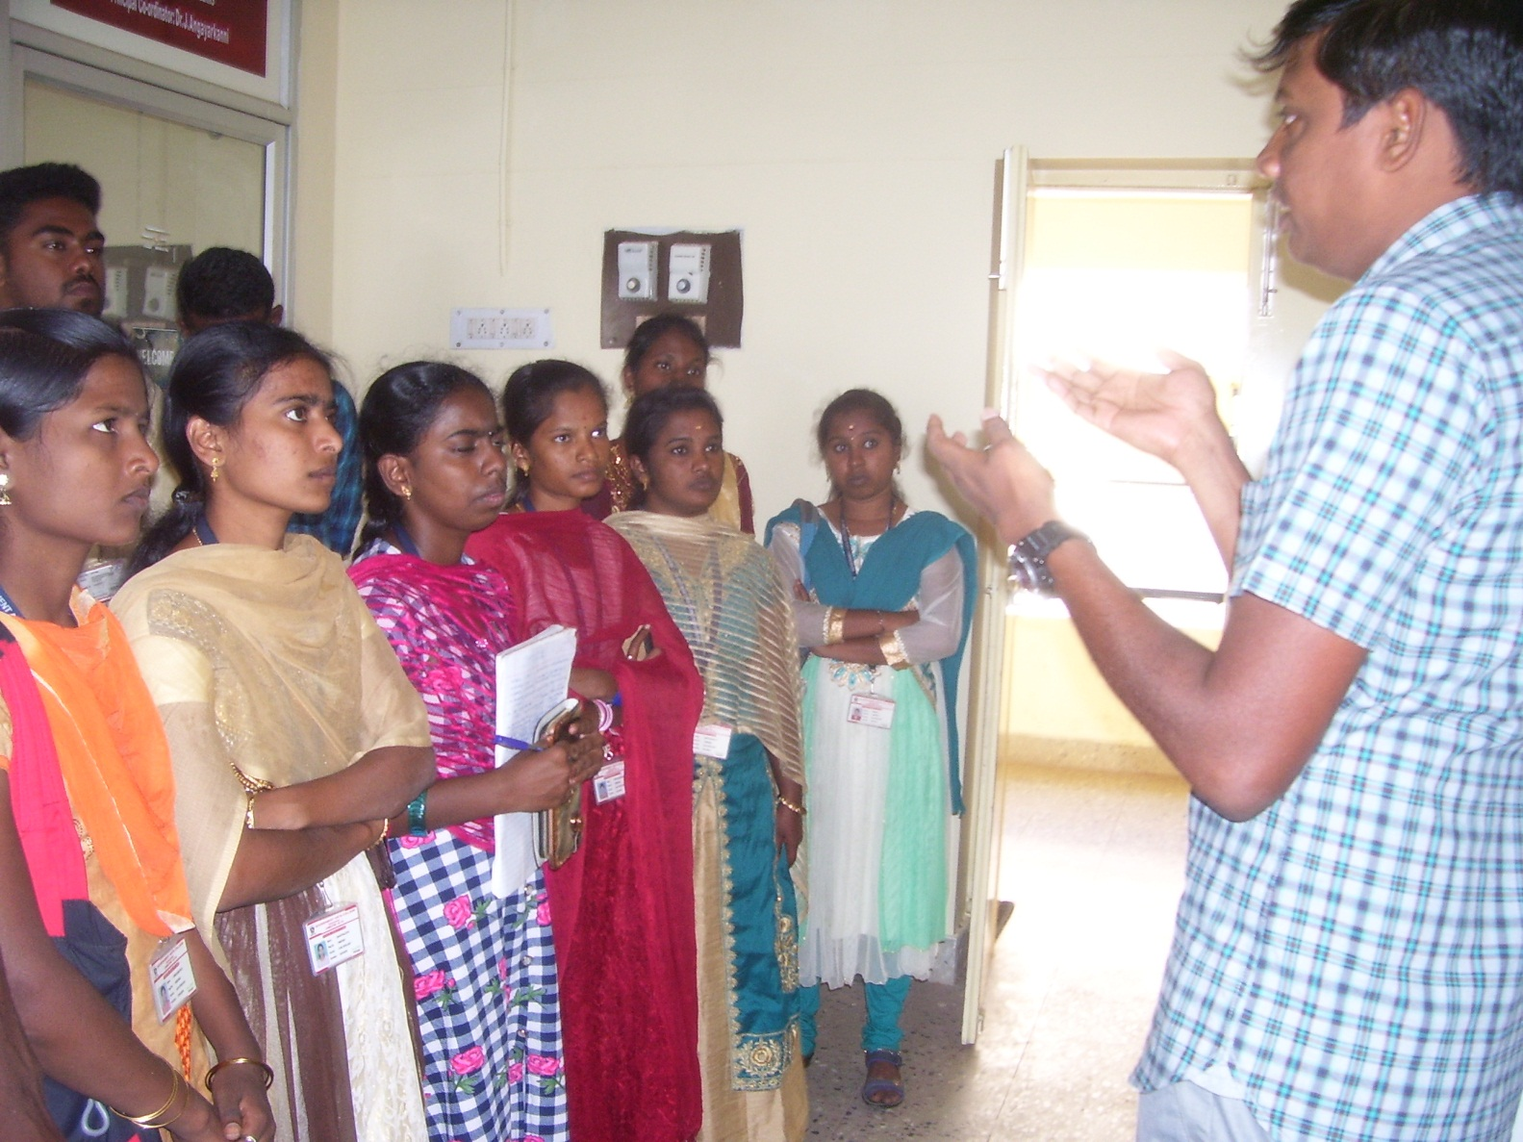
Dept. of Microbial Biotechnology, Bharathiar University, Coimbatore

Slide 5
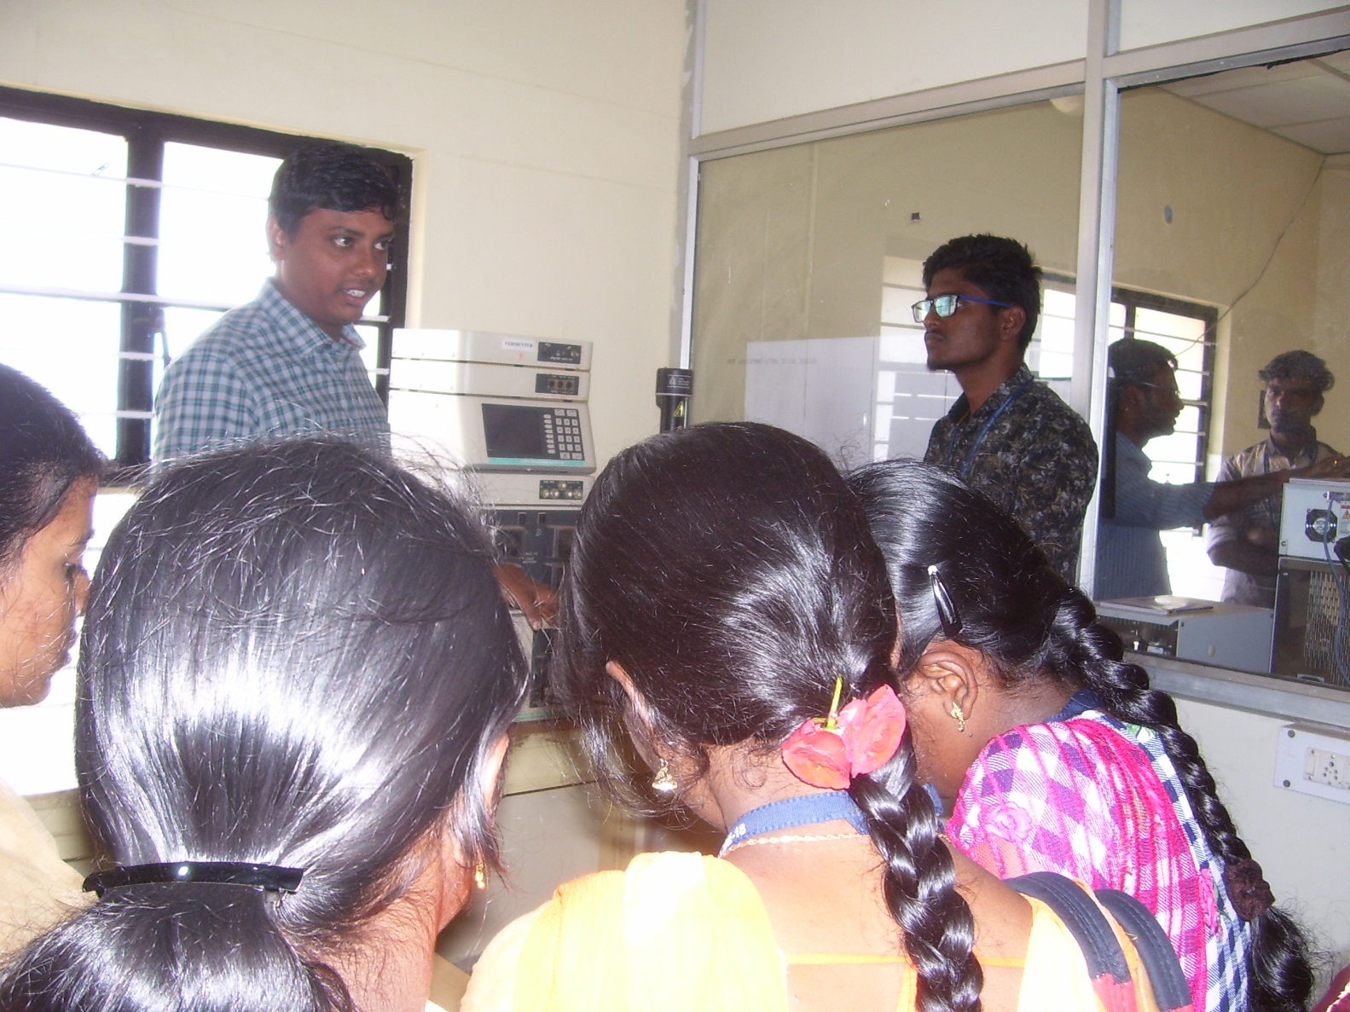
Dept. of Microbial Biotechnology, Bharathiar University, Coimbatore

Slide 6
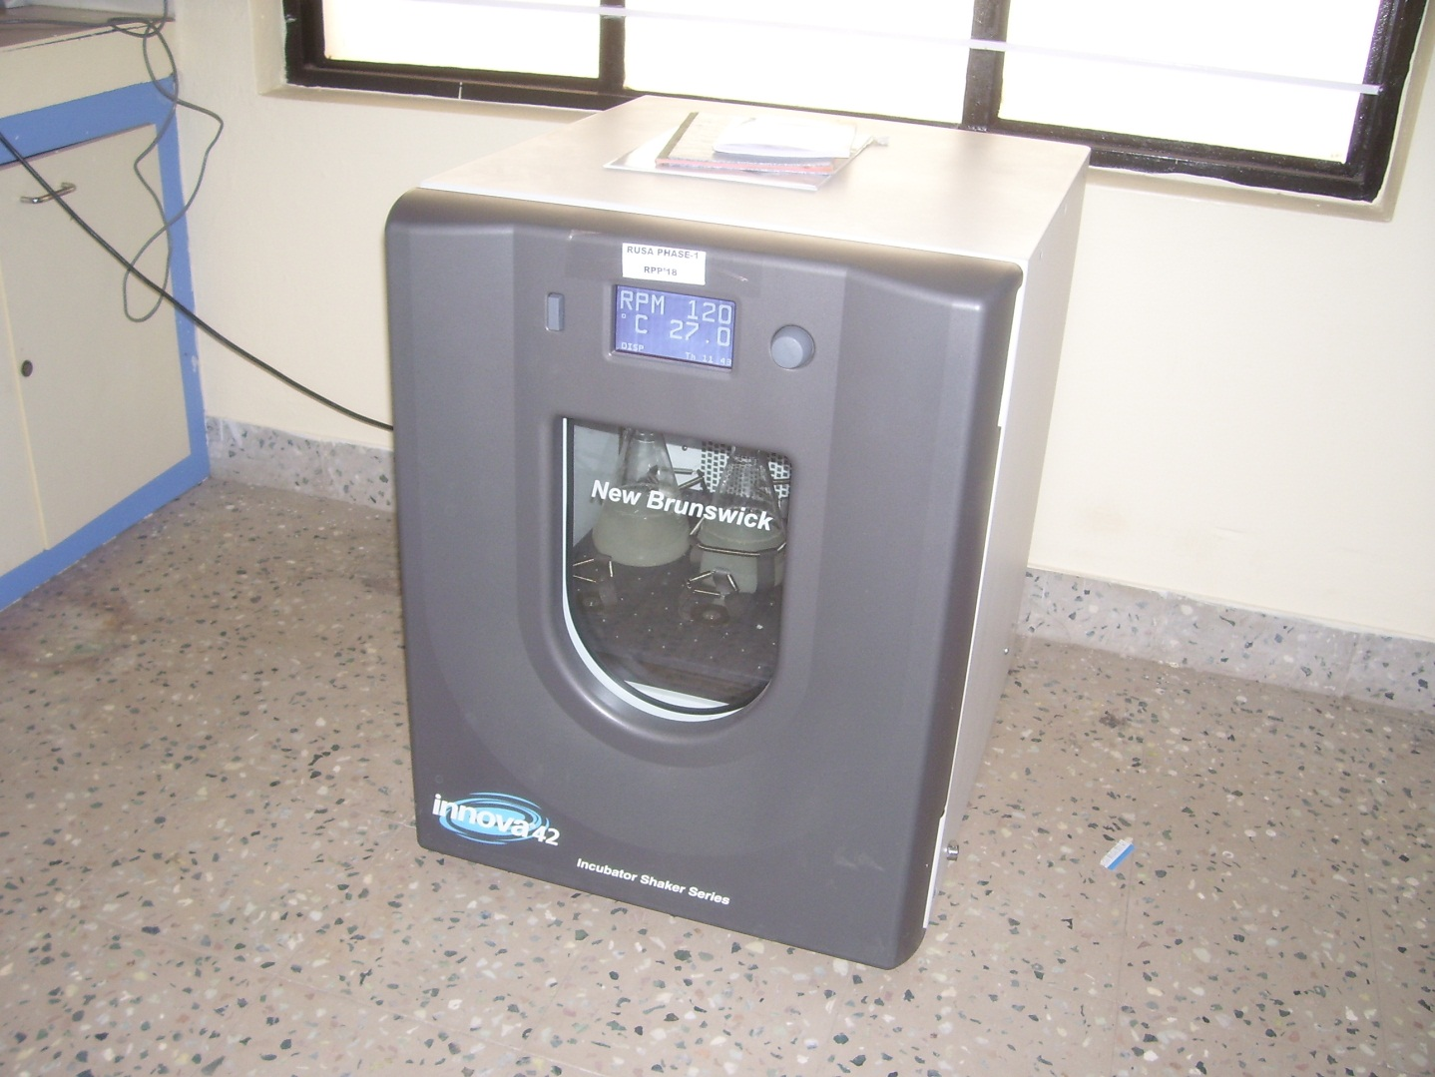
Dept. of Microbial Biotechnology, Bharathiar University, Coimbatore
Incubator Shaker

Slide 7
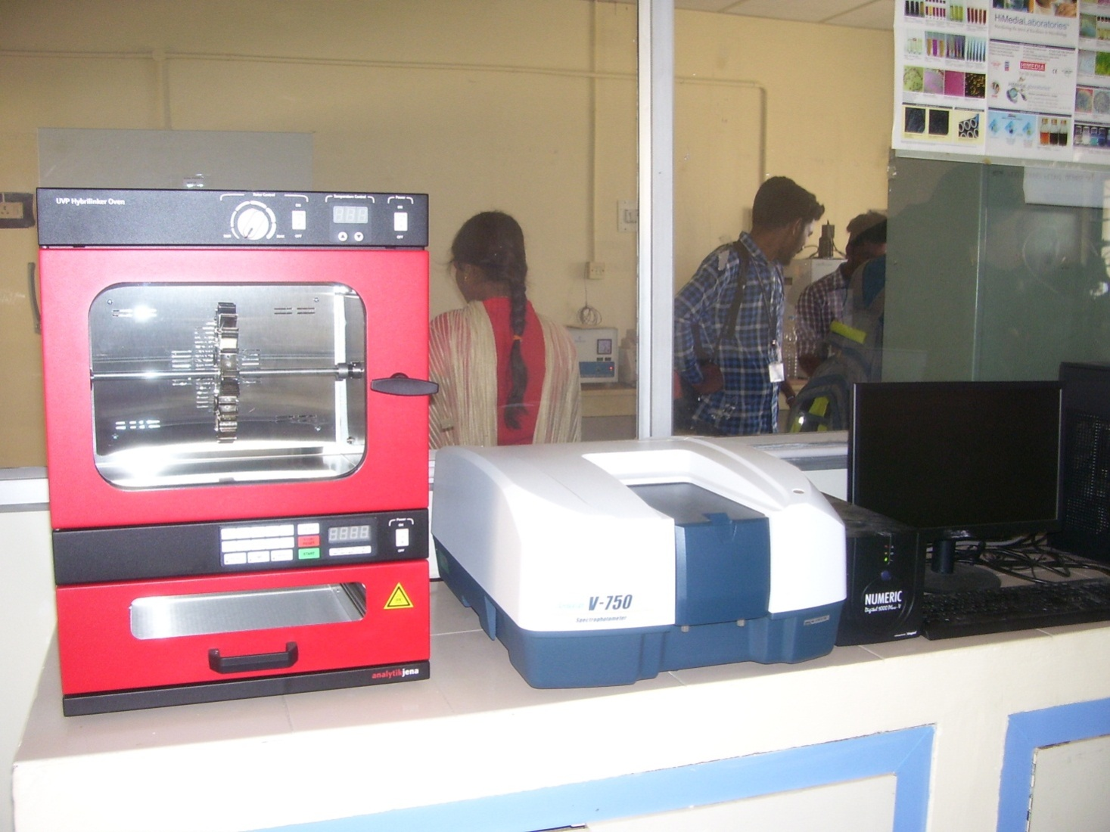
Dept. of Microbial Biotechnology, Bharathiar University, Coimbatore
Hybrilinker Oven

Slide 8
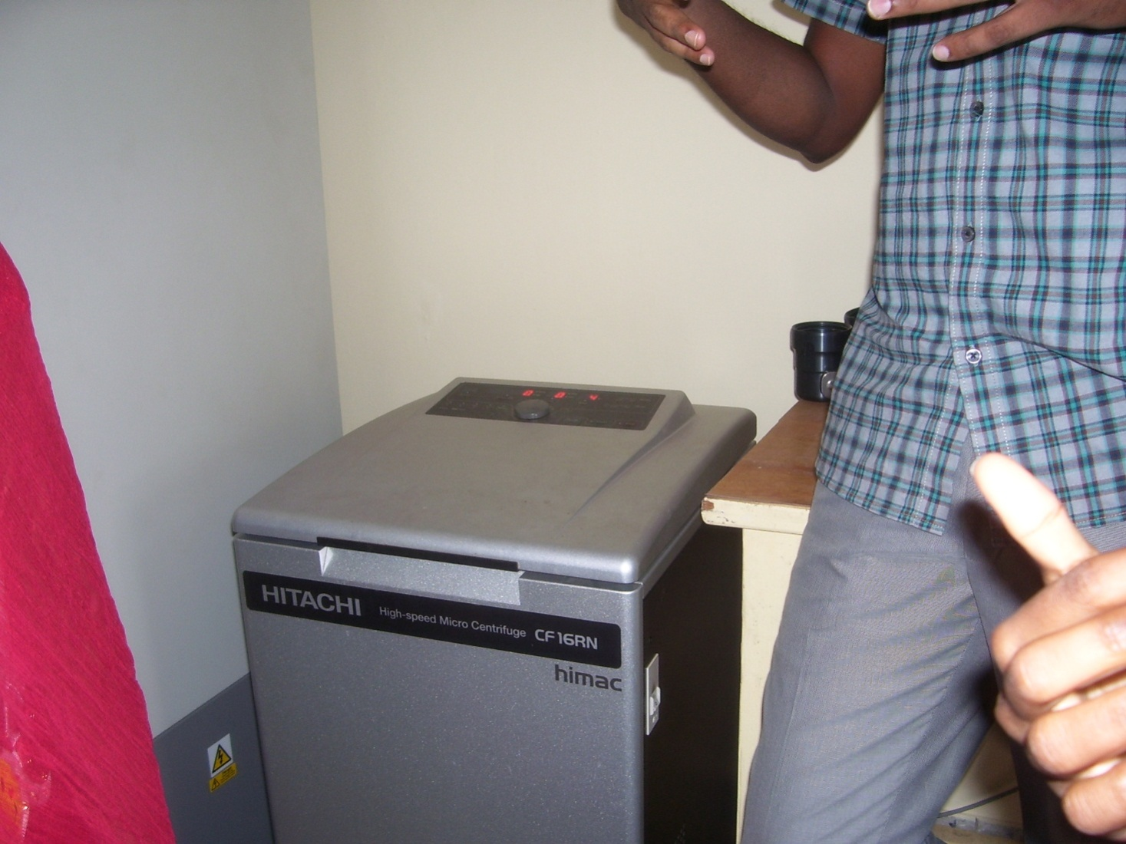
Dept. of Microbial Biotechnology, Bharathiar University, Coimbatore
Micro Centrifuge

Slide 9
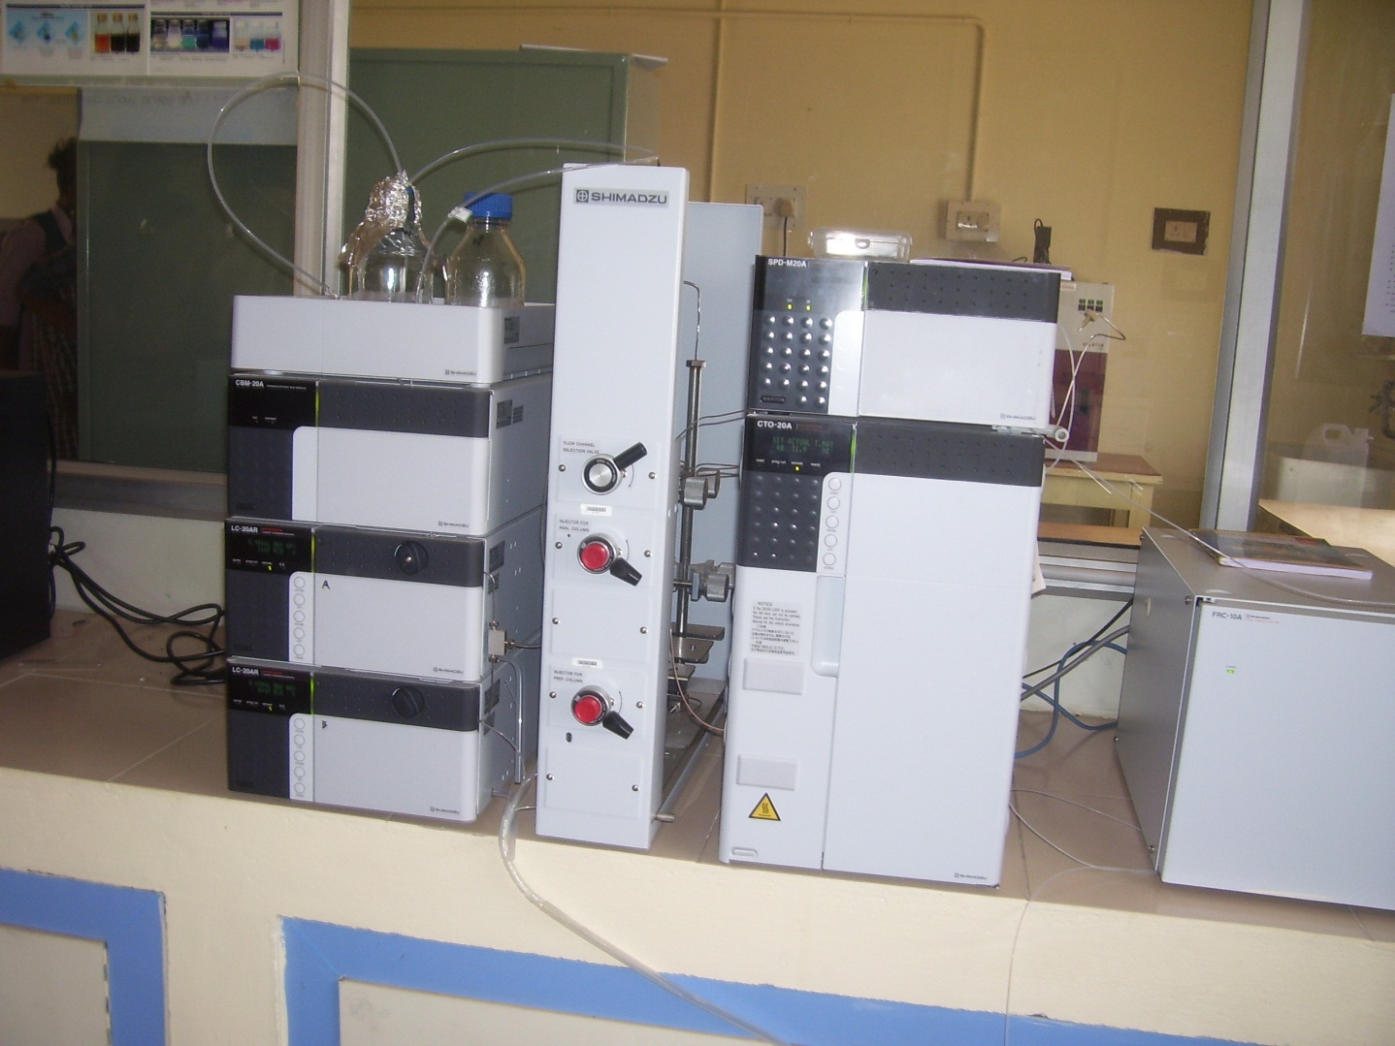
Dept. of Microbial Biotechnology, Bharathiar University, Coimbatore
High Performance Liquid Chromatography (HPLC)

Slide 10
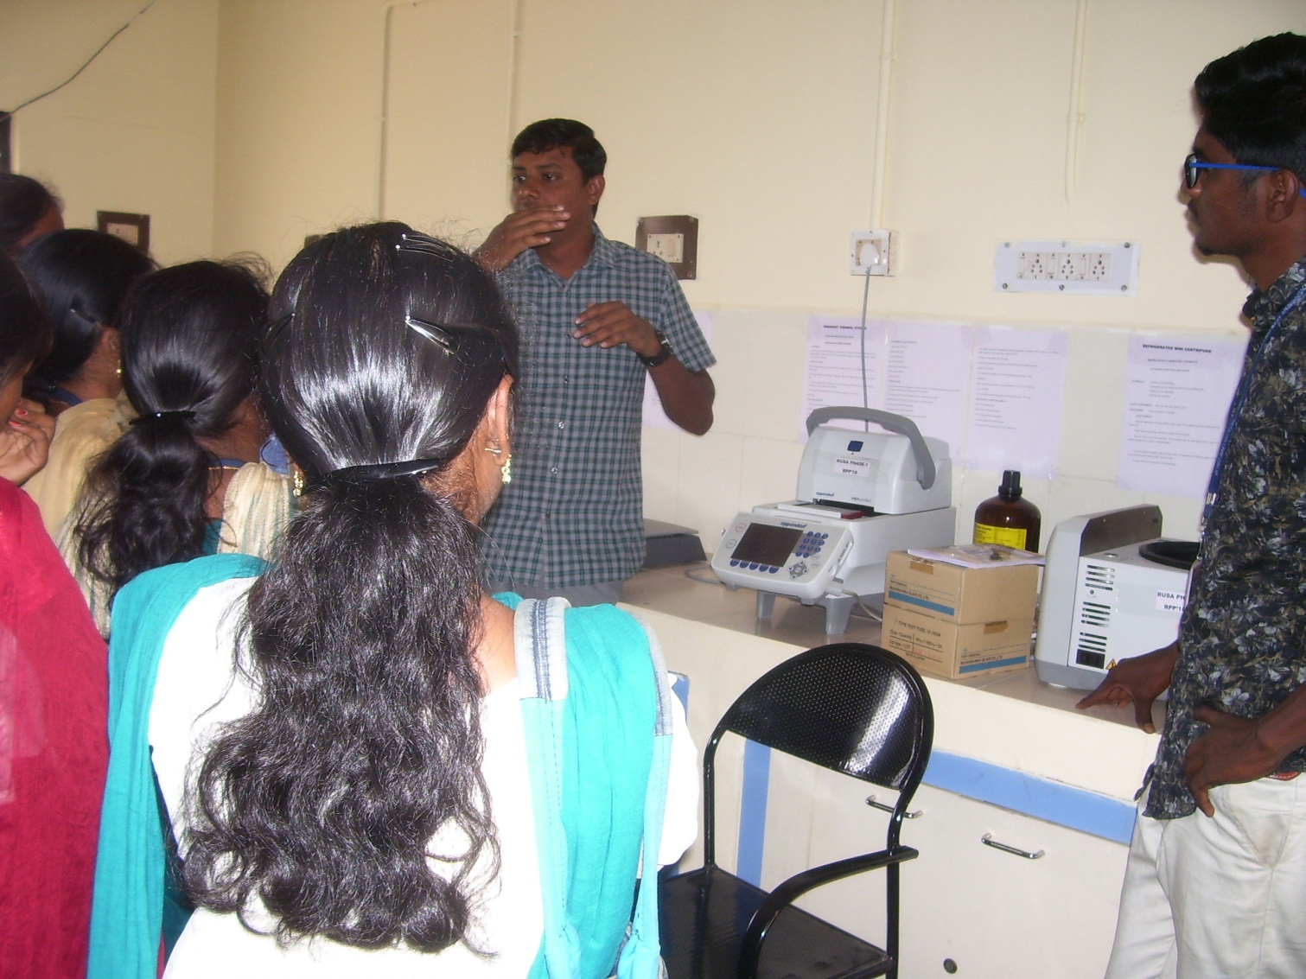
Dept. of Microbial Biotechnology, Bharathiar University, Coimbatore

Slide 11
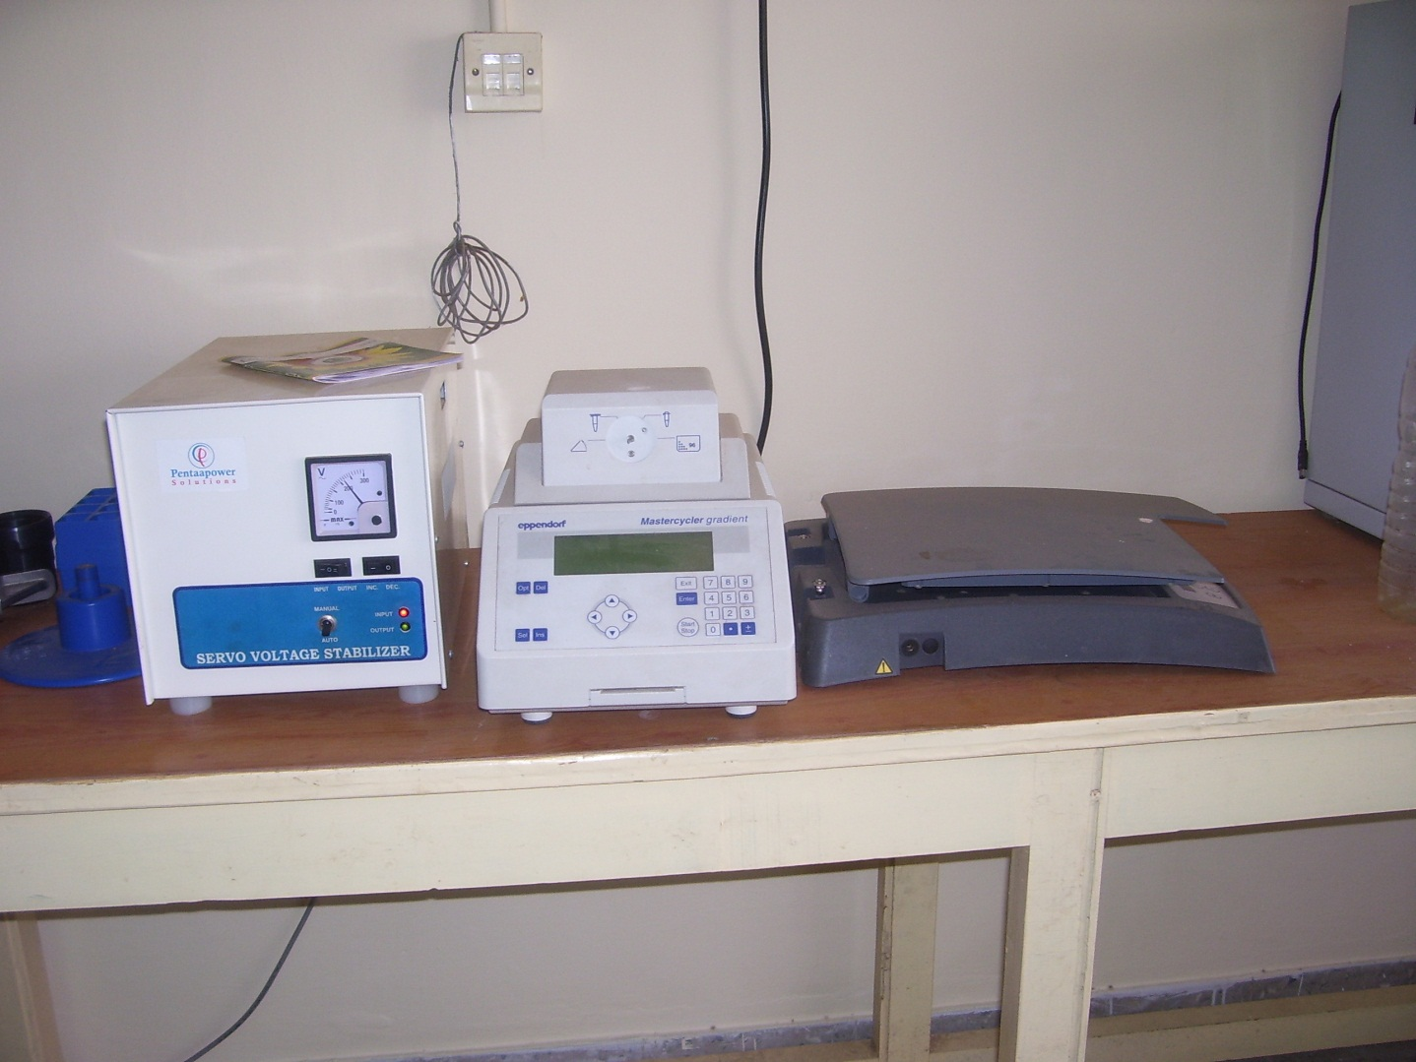
Dept. of Microbial Biotechnology, Bharathiar University, Coimbatore
Thermal Cycler

Slide 12
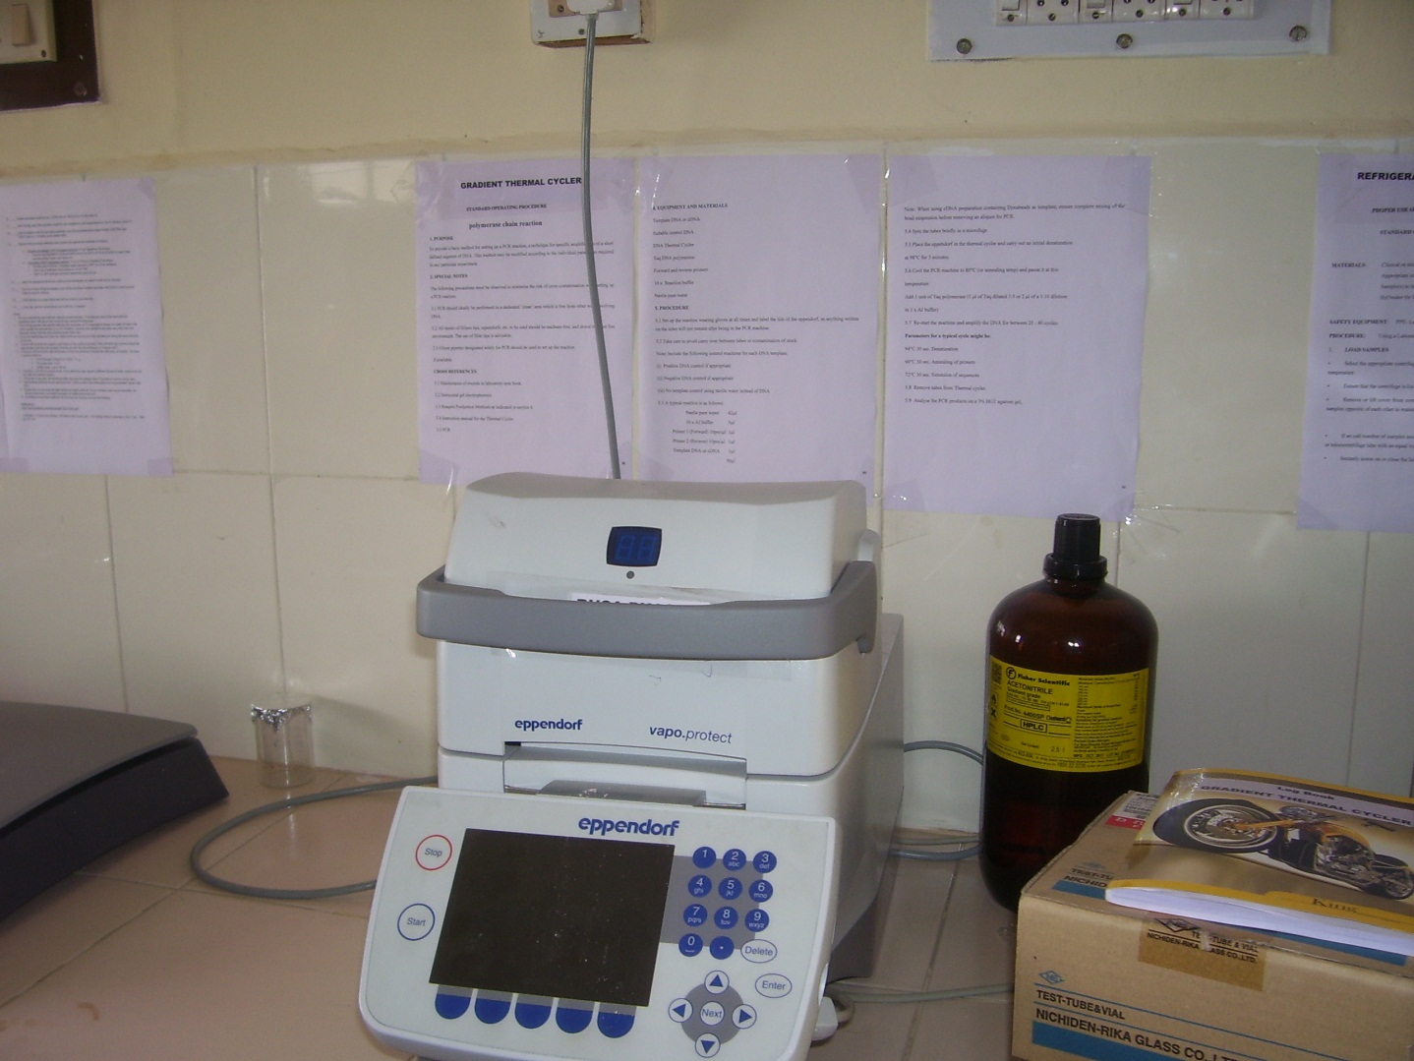
Dept. of Microbial Biotechnology, Bharathiar University, Coimbatore
PCR

Slide 13
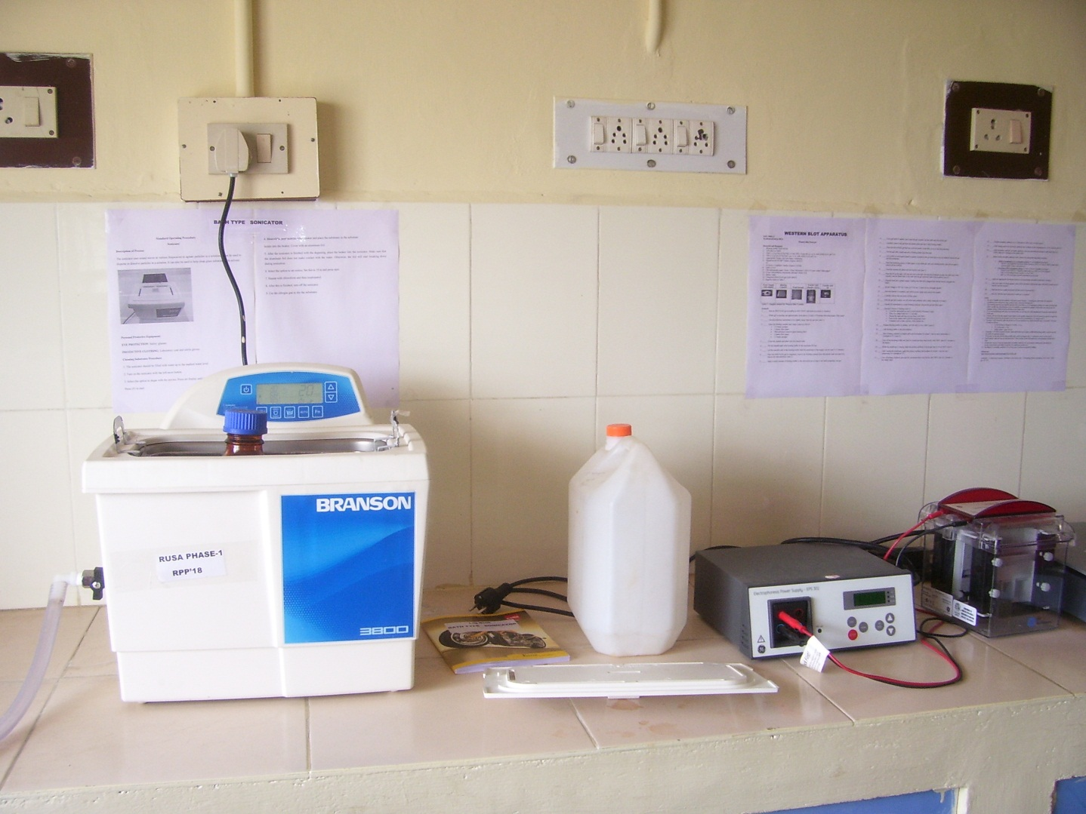
Dept. of Microbial Biotechnology, Bharathiar University, Coimbatore
Sonicator

Slide 14
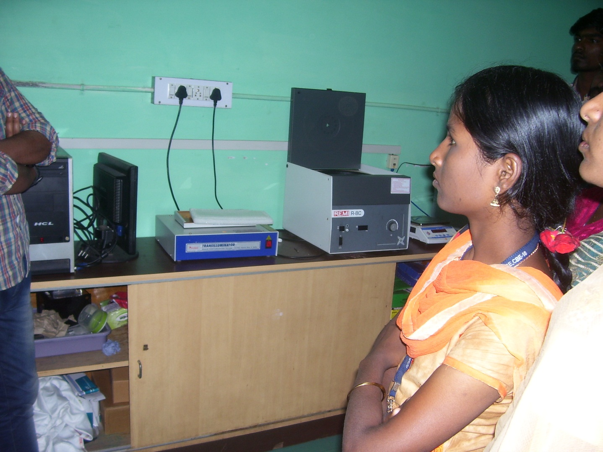
Dept. of Microbial Biotechnology, Bharathiar University, Coimbatore
Transilluminator

Slide 15
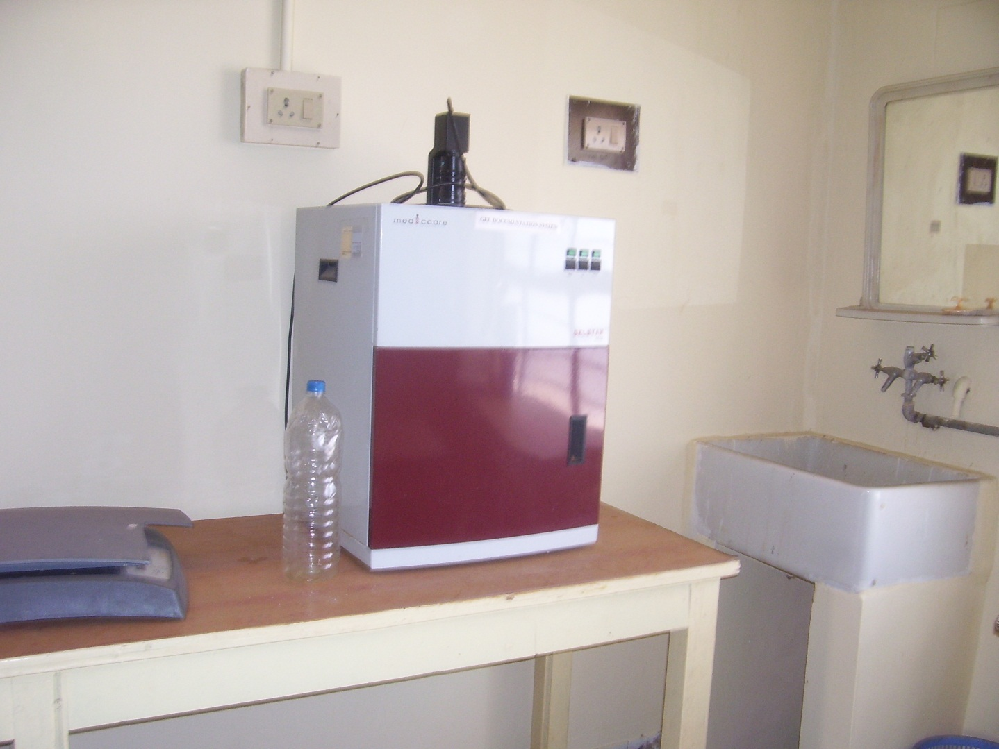
Dept. of Microbial Biotechnology, Bharathiar University, Coimbatore
Gel Documentation System

Slide 16
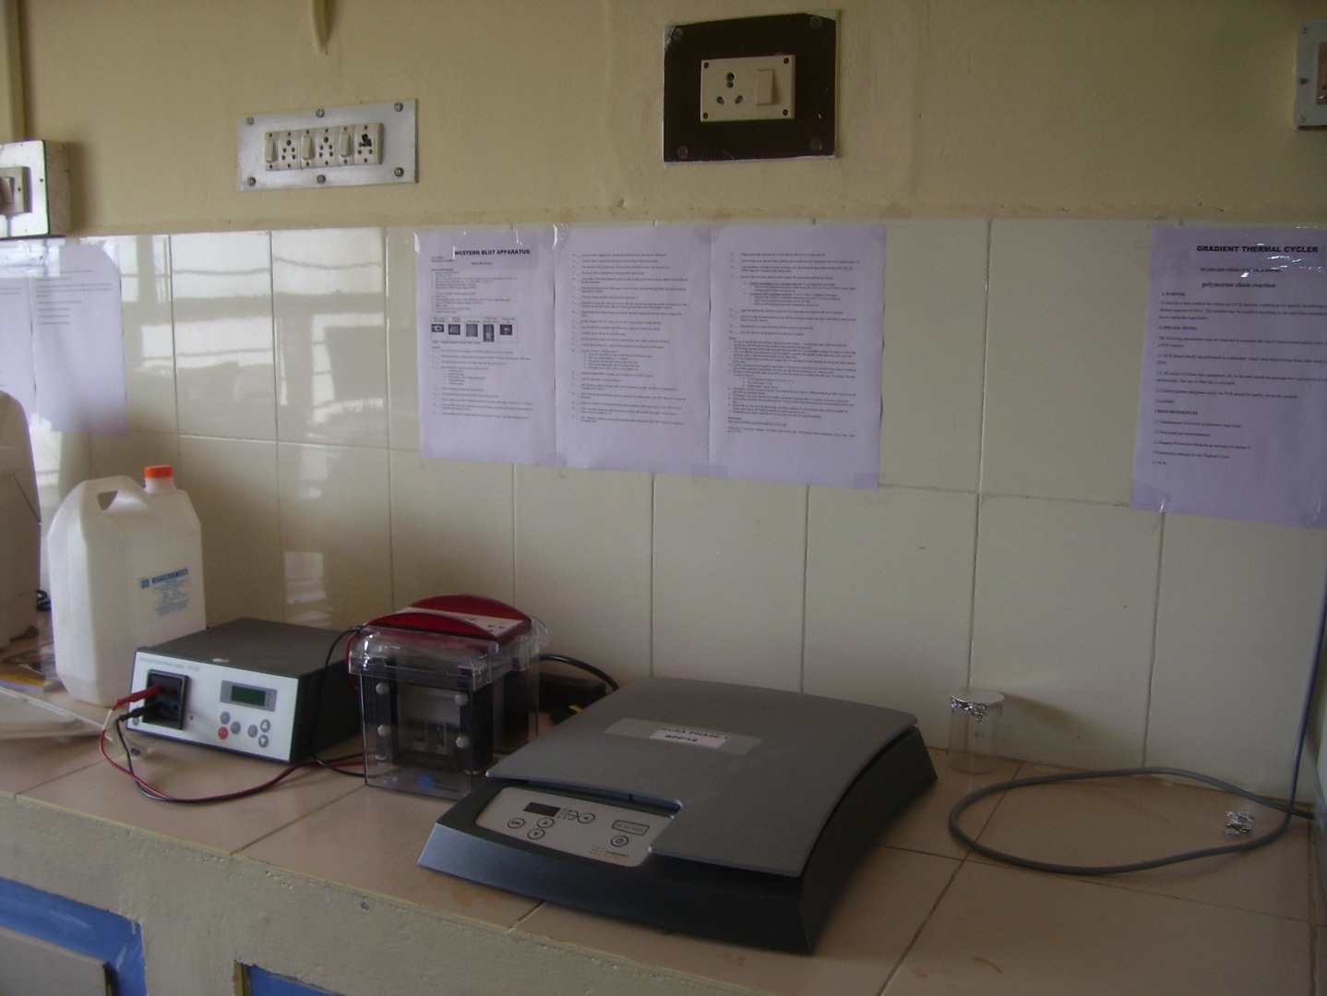
Dept. of Microbial Biotechnology, Bharathiar University, Coimbatore
Western Blot

Slide 17
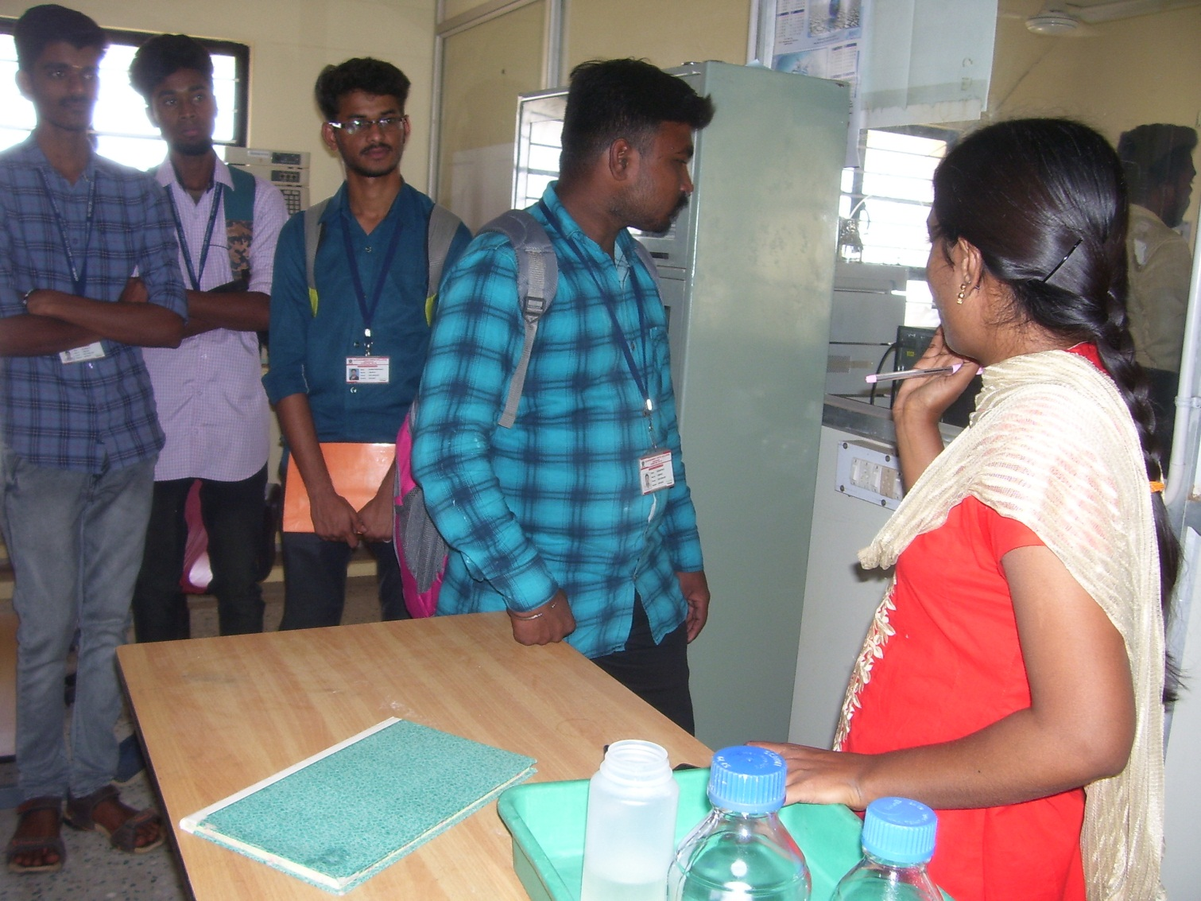
Dept. of Microbial Biotechnology, Bharathiar University, Coimbatore

Slide 18
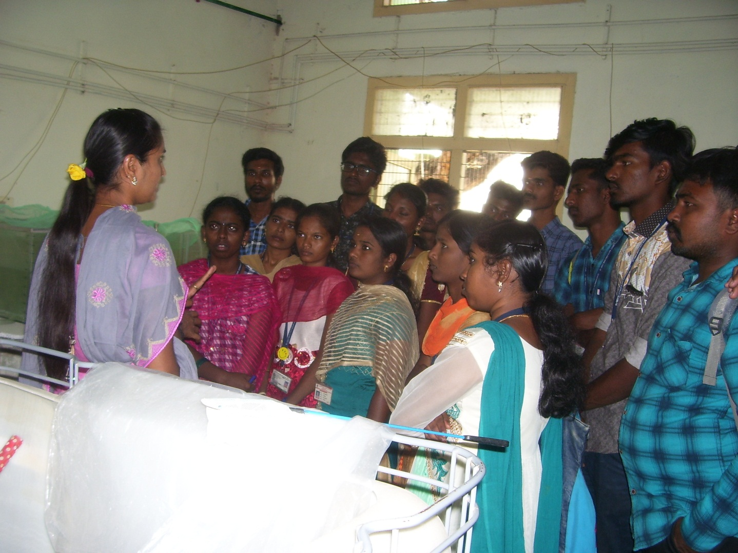
Department of Zoology, Bharathiar University, Coimbatore
Ecotoxicology Laboratory

Slide 19
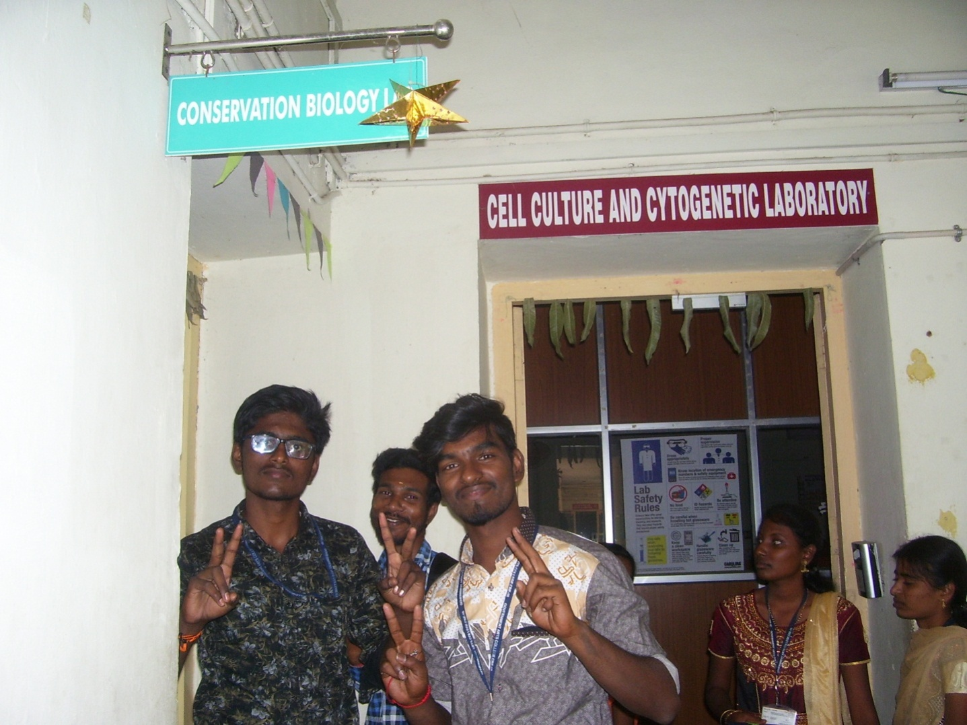
Department of Zoology, Bharathiar University, Coimbatore
Cytogenetics Laboratory

Slide 20
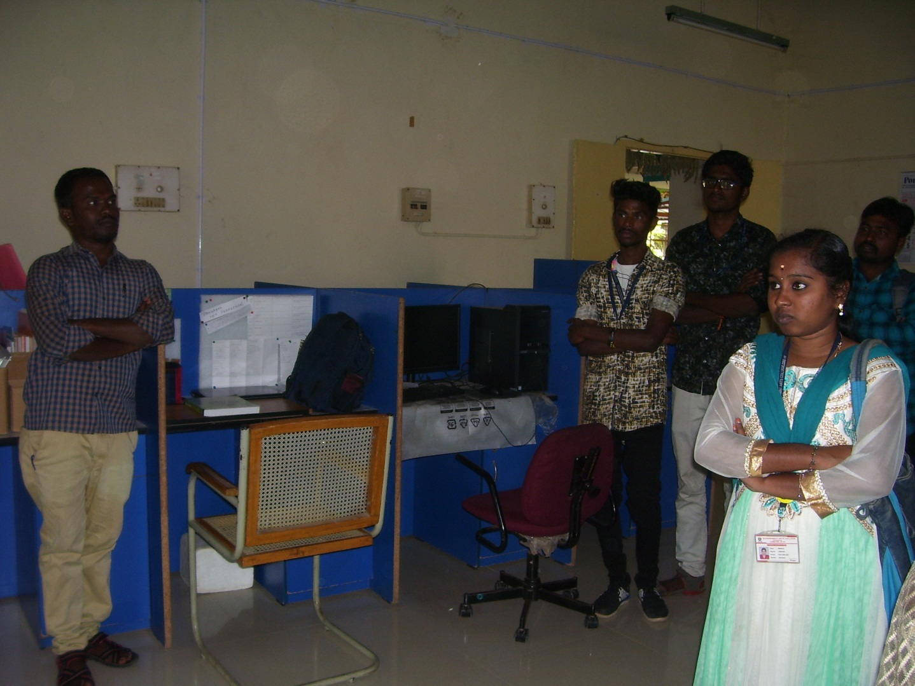
Department of Zoology, Bharathiar University, Coimbatore
Conservation Biology Laboratory

Slide 21
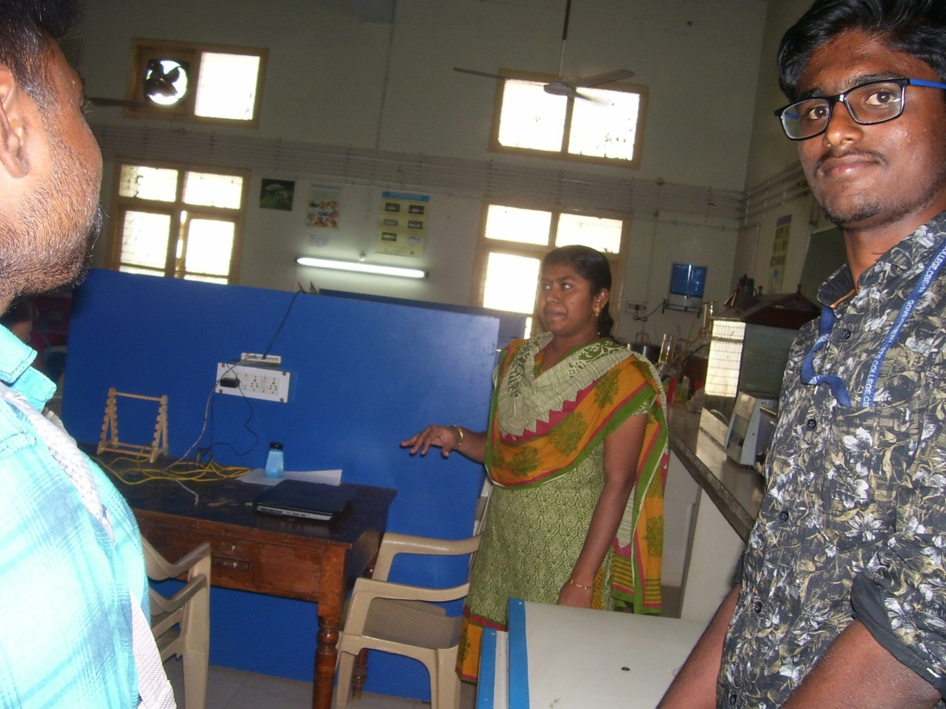
Department of Zoology, Bharathiar University, Coimbatore
Conservation Biology Laboratory

Slide 22
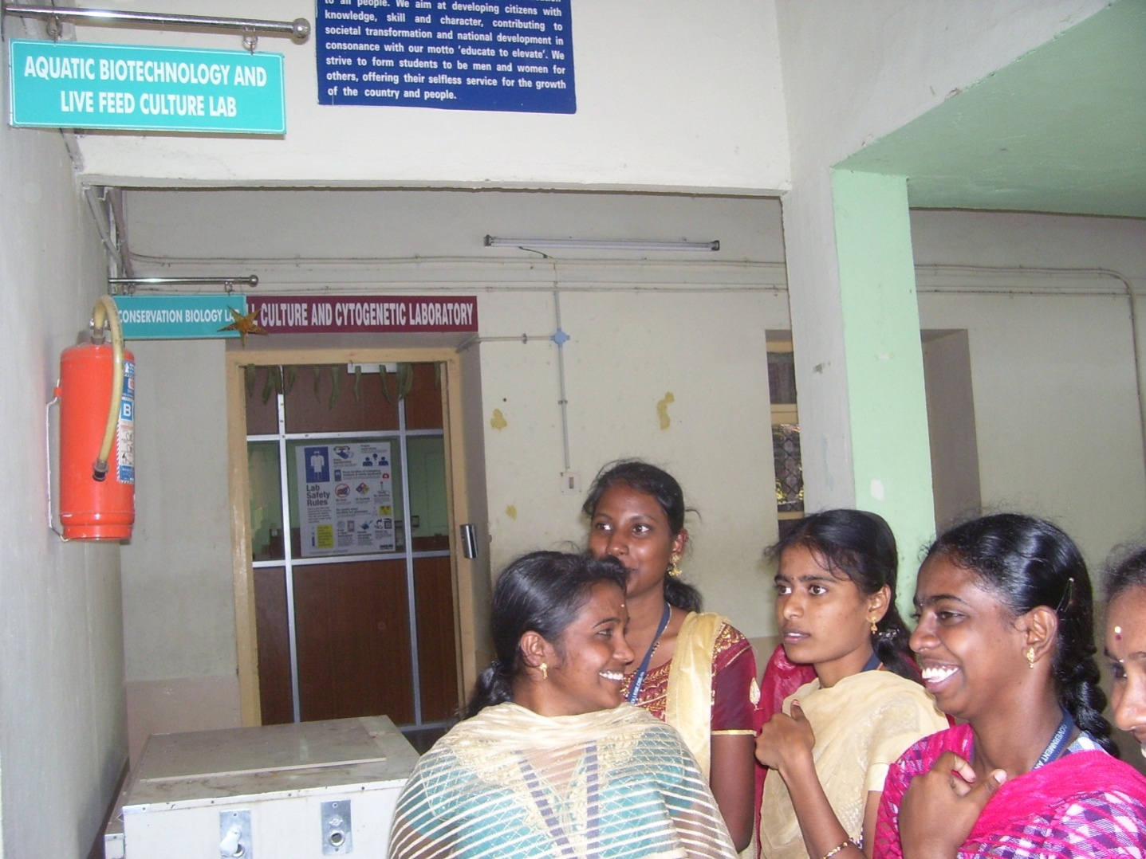
Department of Zoology, Bharathiar University, Coimbatore
Aquatic Biotechnology & Live Feed Culture Laboratory

Slide 23
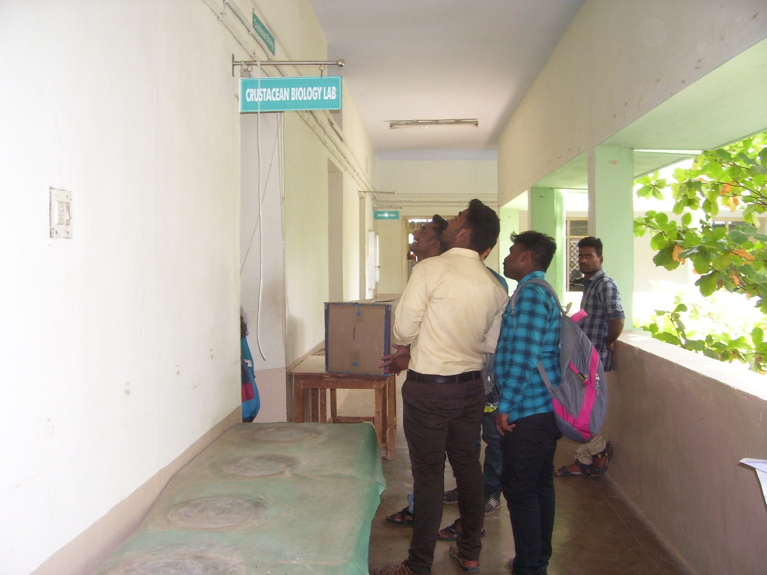
Department of Zoology, Bharathiar University, Coimbatore
Crustacean Biology Laboratory

Slide 24
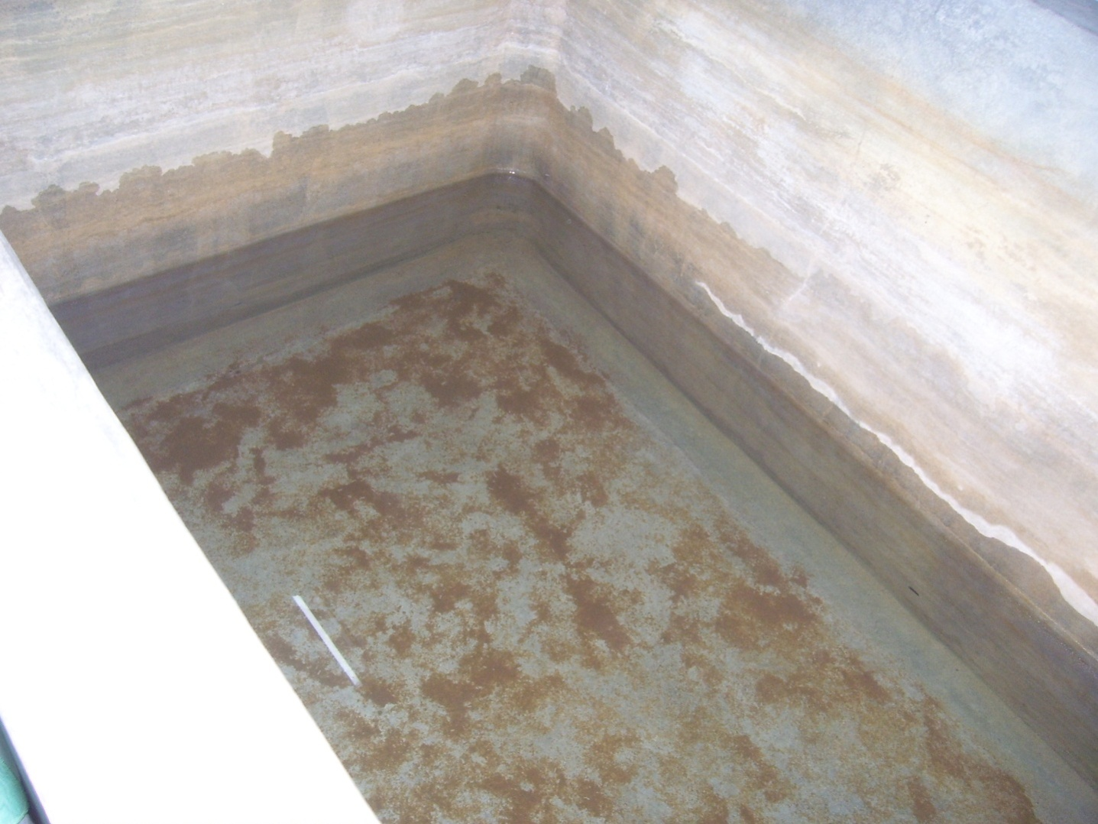
Department of Zoology, Bharathiar University, Coimbatore
Crustacean Biology Laboratory

Slide 25
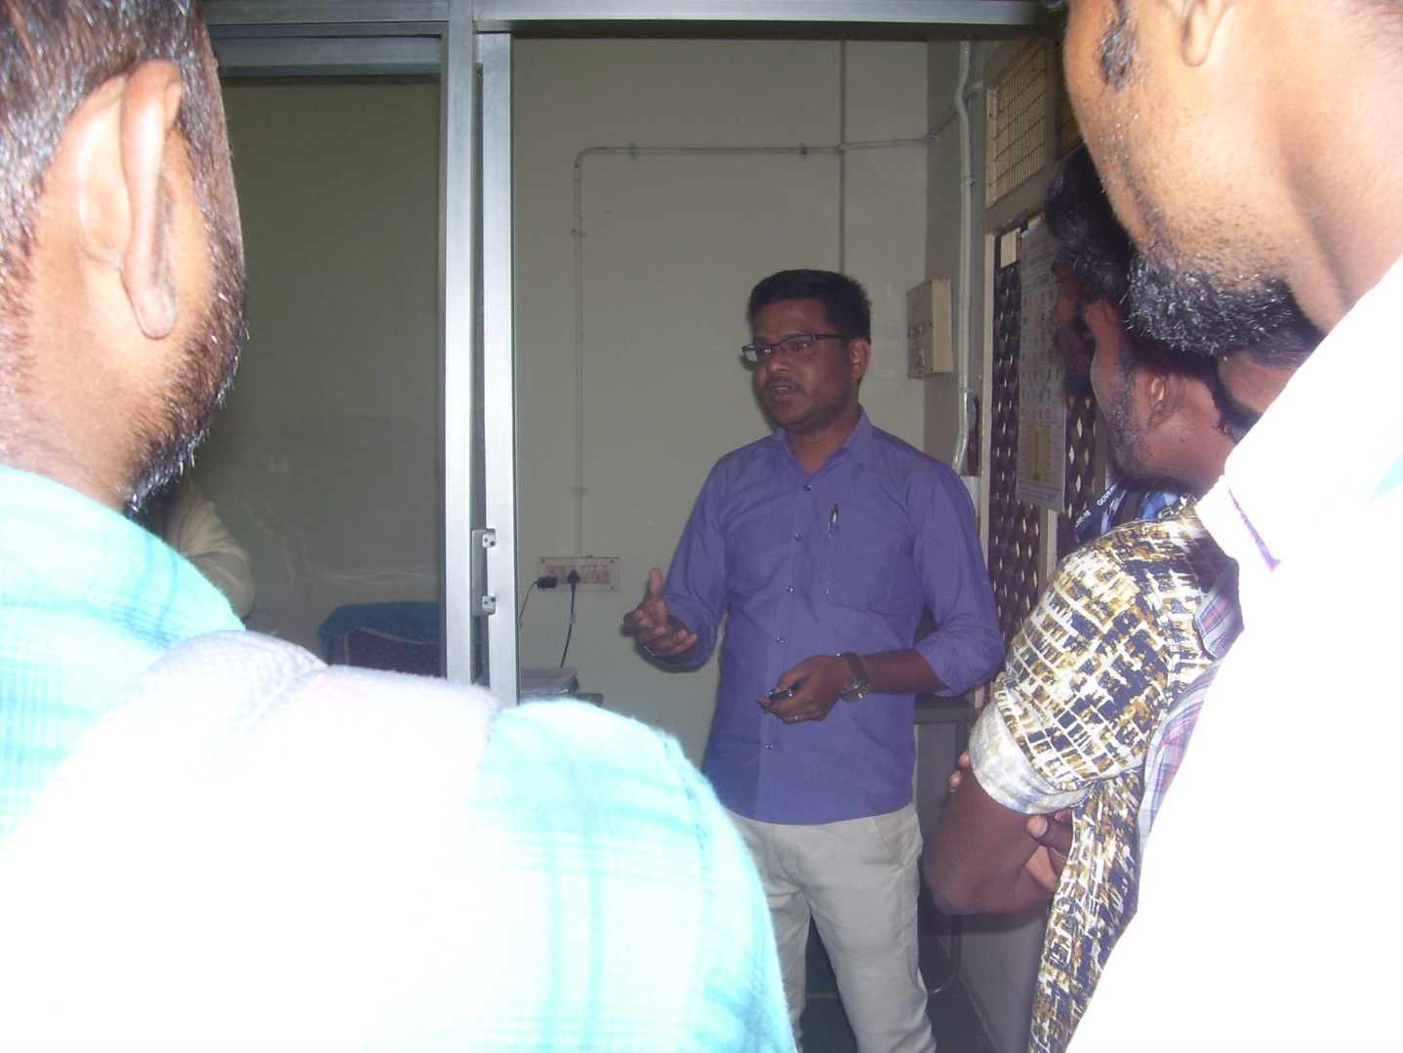
Department of Zoology, Bharathiar University, Coimbatore
Cancer Biology Laboratory

Slide 26
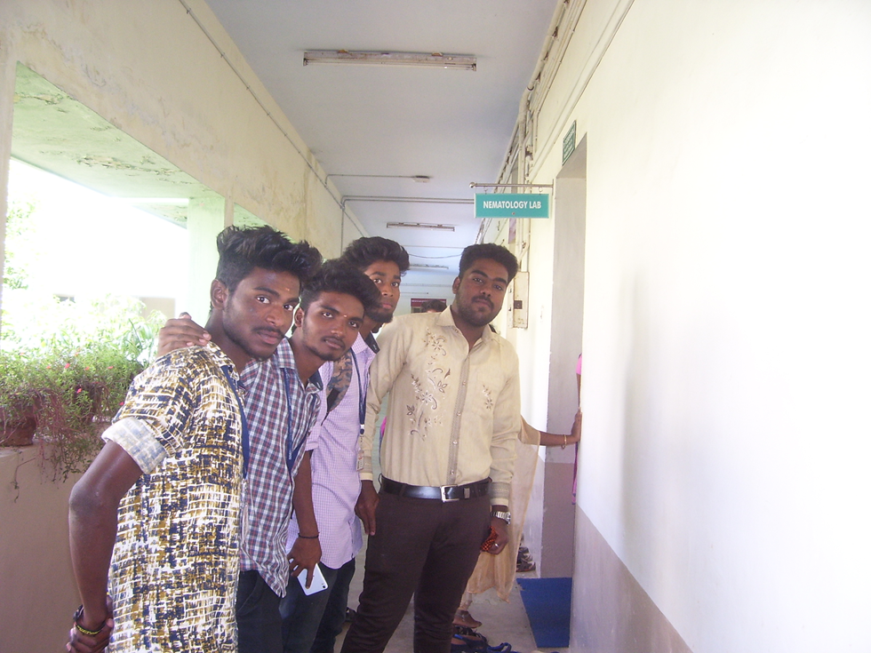
Department of Zoology, Bharathiar University, Coimbatore
Nematology Laboratory

Slide 27
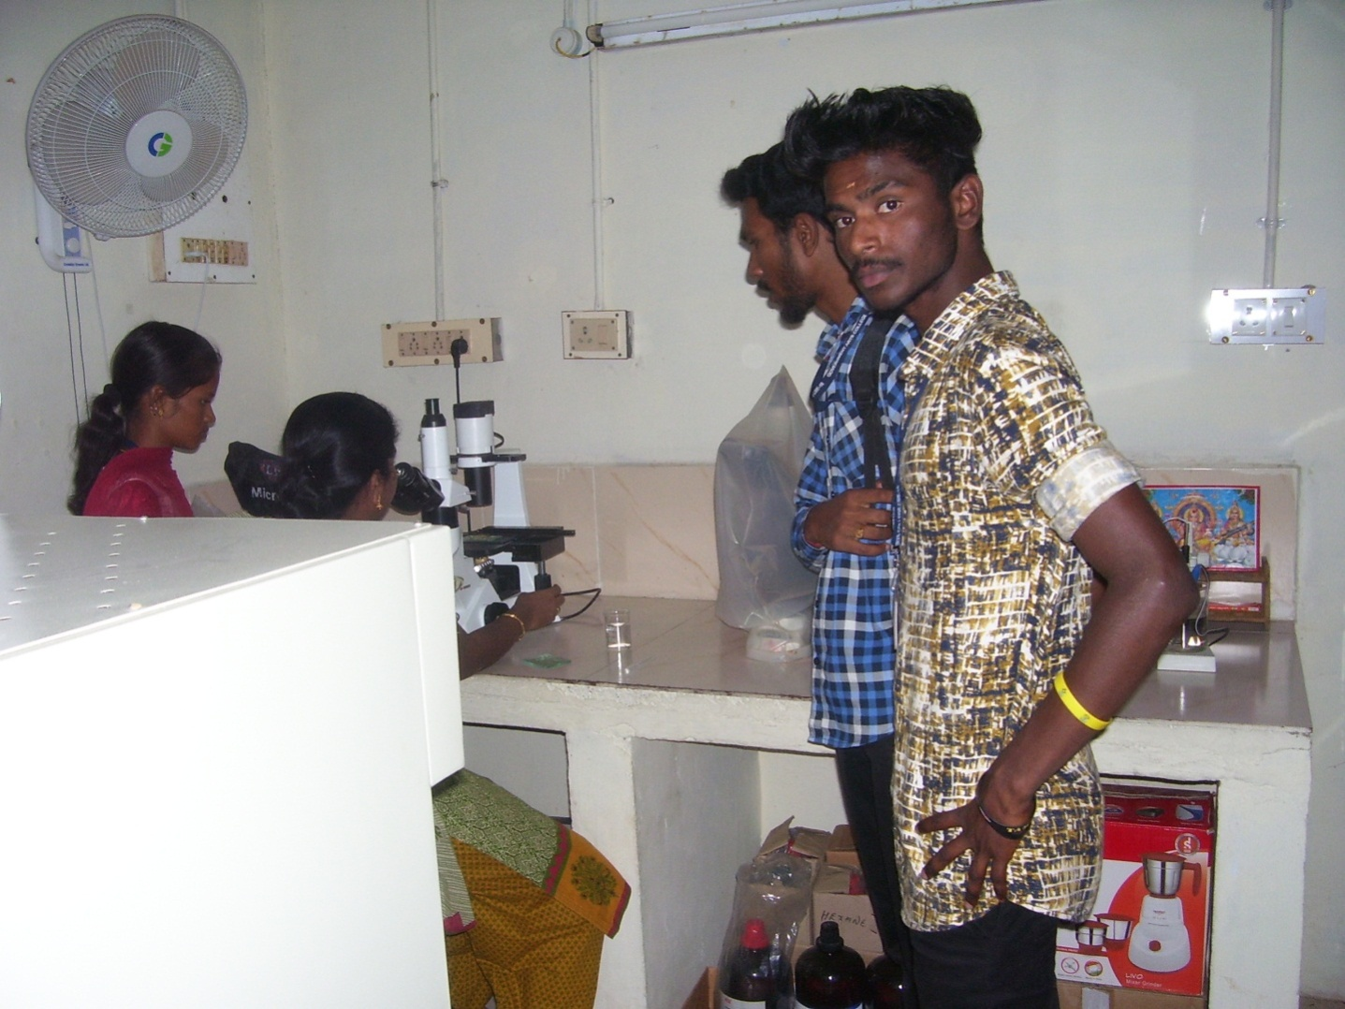
Department of Zoology, Bharathiar University, Coimbatore
Nematology Laboratory

Slide 28
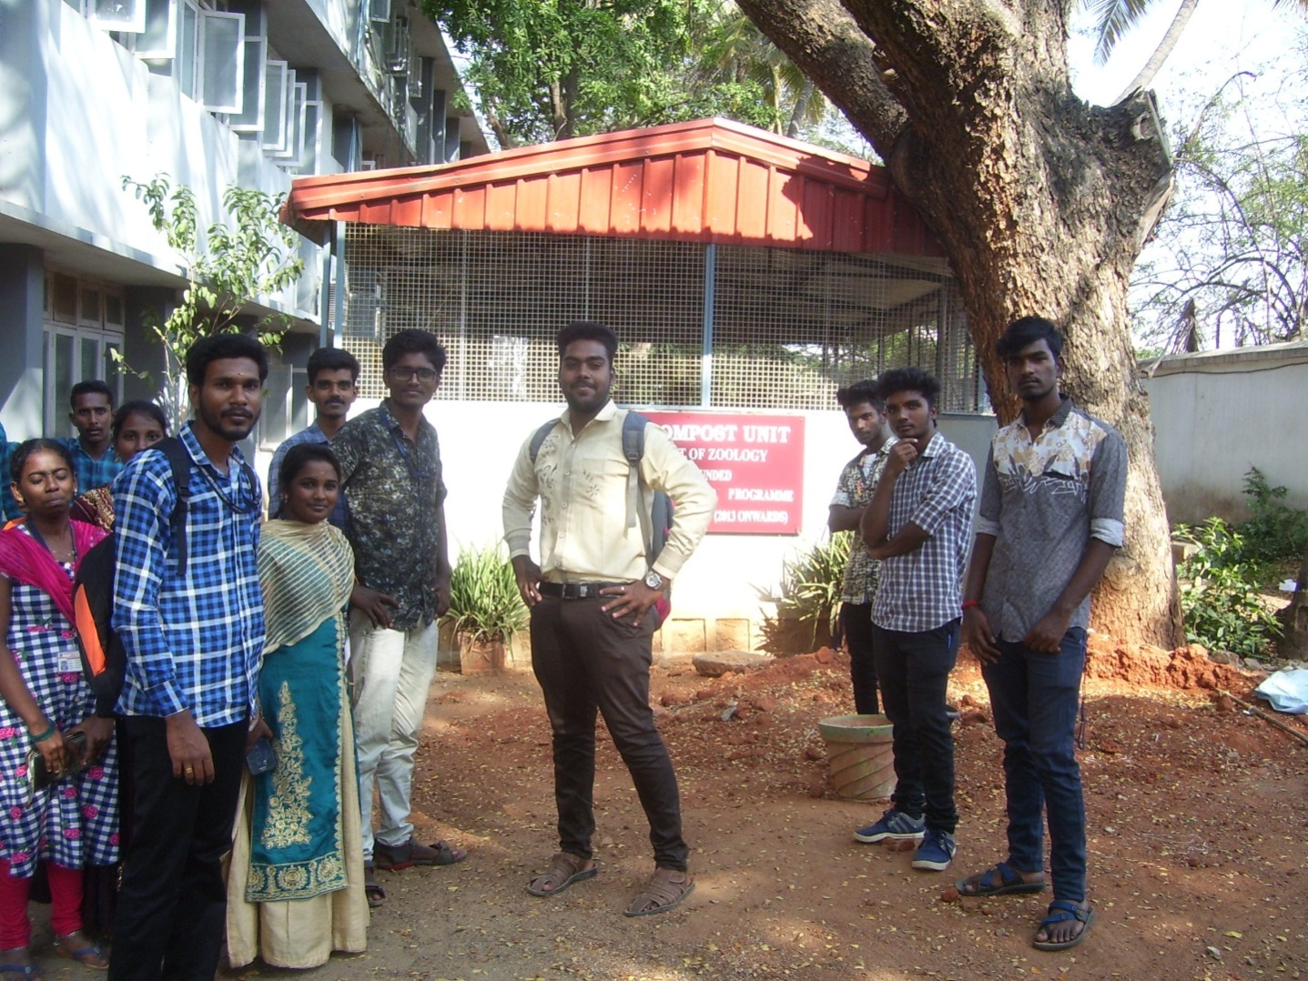
Nirmala College for Women, Coimbatore
Vermiculture & Vermicomposting Plant

Slide 29
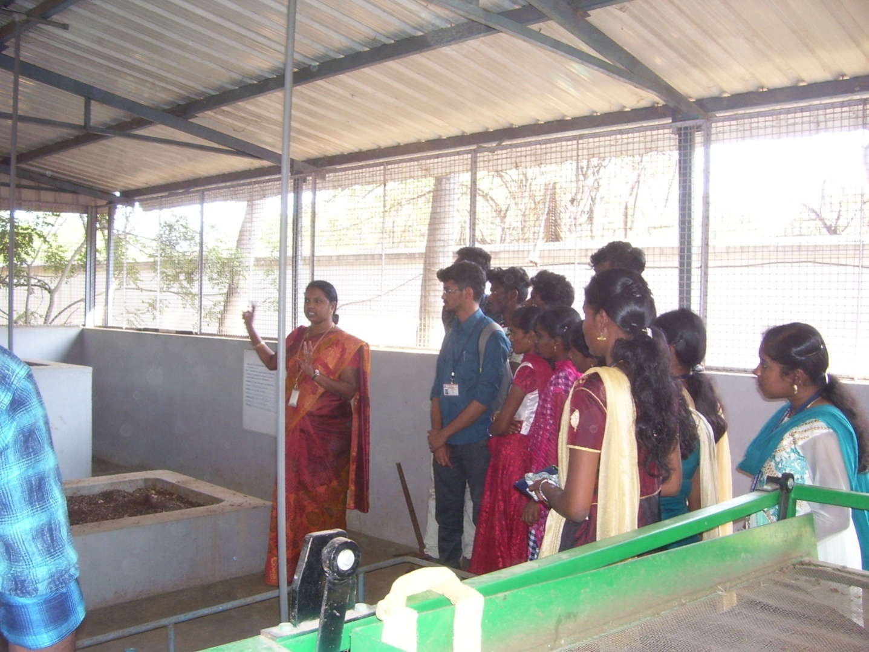
Nirmala College for Women, Coimbatore
Vermiculture & Vermicomposting Plant

Slide 30
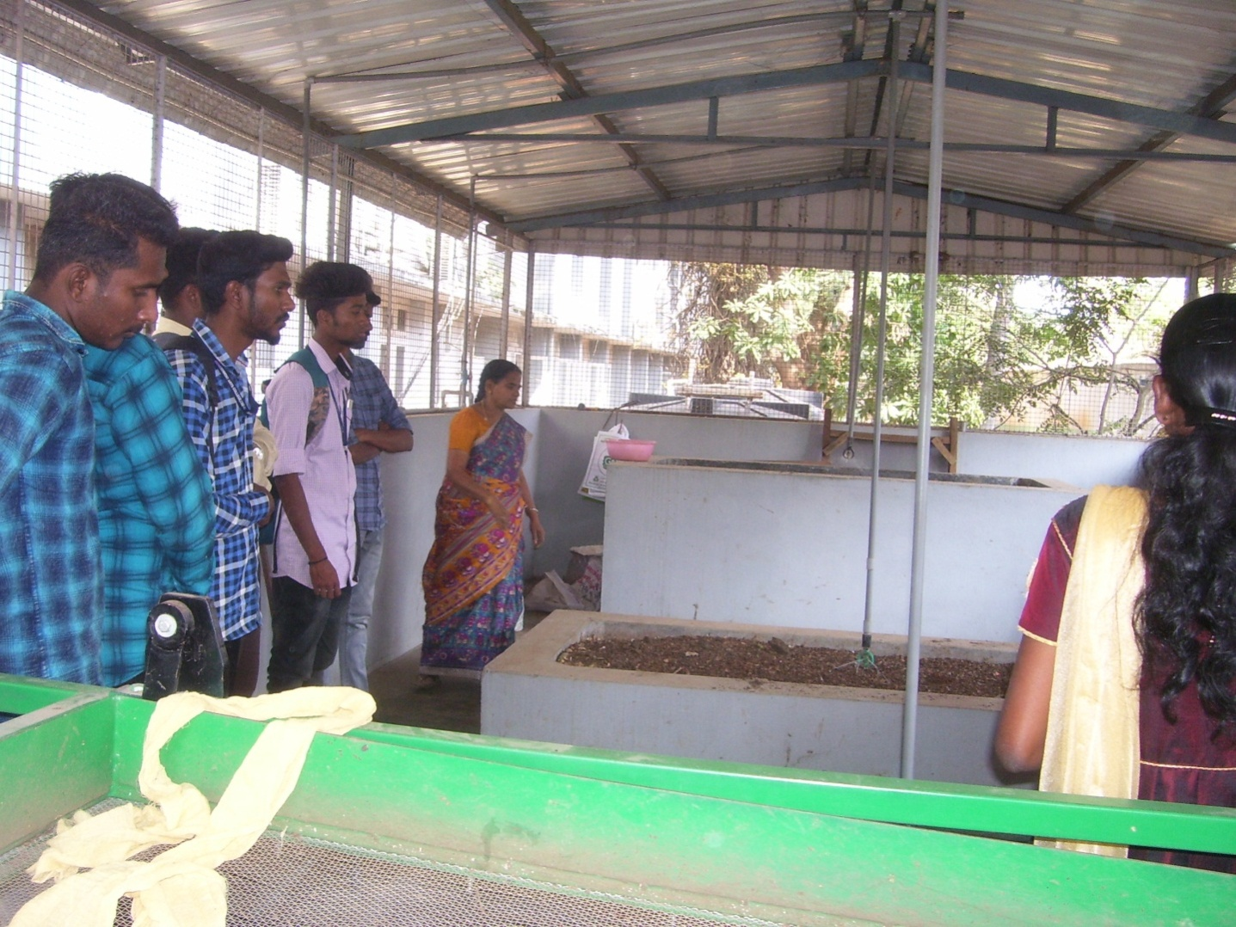
Nirmala College for Women, Coimbatore
Vermiculture & Vermicomposting Plant

Slide 31
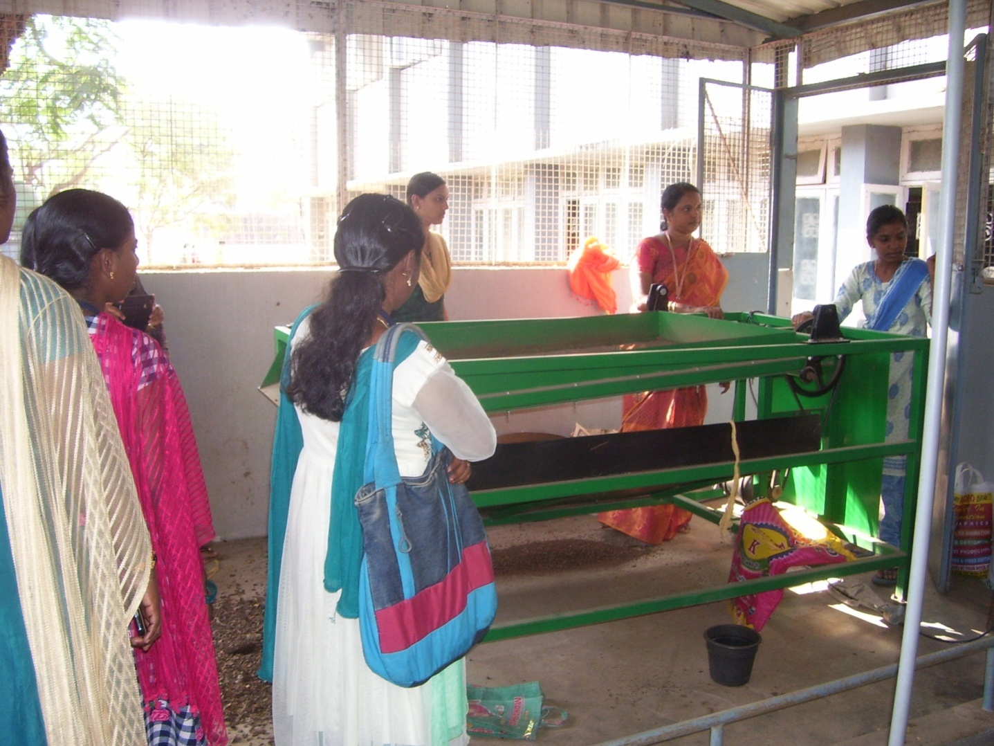
Nirmala College for Women, Coimbatore
Vermiculture & Vermicomposting Plant

Slide 32
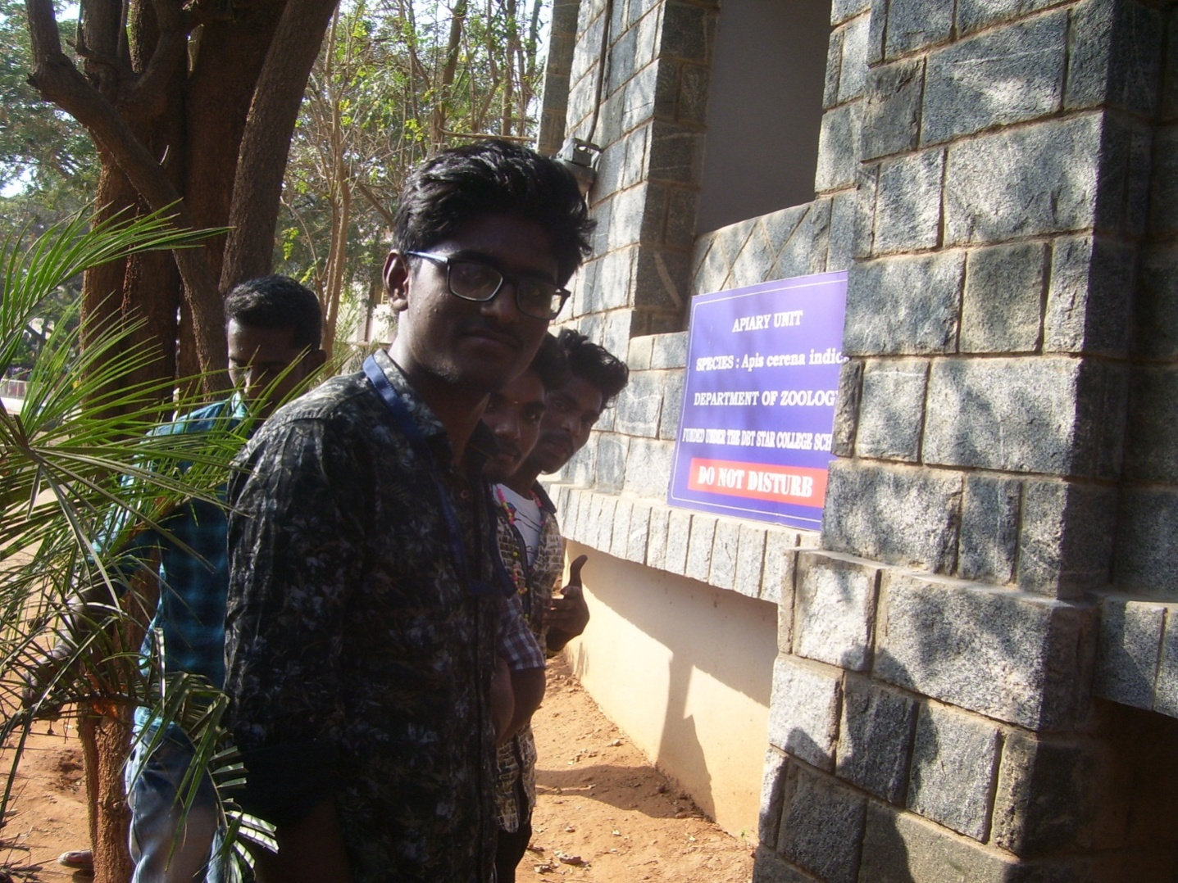
Nirmala College for Women, Coimbatore
Apiary Unit

Slide 33
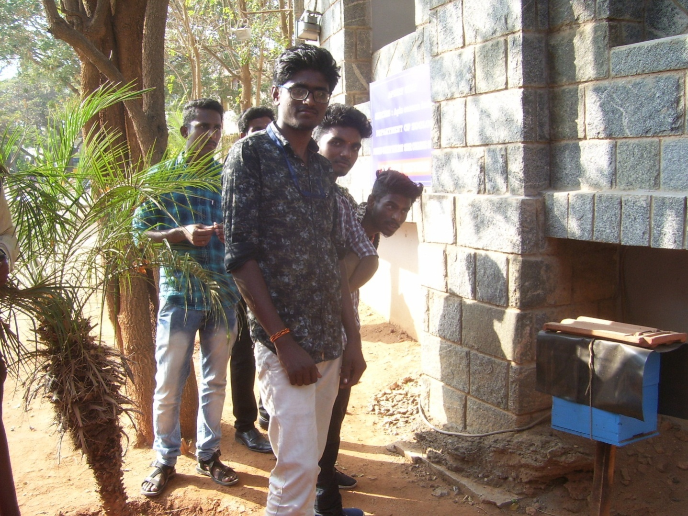
Nirmala College for Women, Coimbatore
Apiary Unit

